Slide 1

EXPLAINABLE AI-BASED STOCK MARKET TREND PREDICTION AND RISK ANALYSIS SYSTEM
by
K. HARSHITHA
Roll No. 234G1A0552
B.MANI DEEPA
Roll No. 244G5A0510
S.ALMASH
Roll No. 234G1A0504
K.BALA SAI
Roll No. 234G1A0518
Under the guidance of
Mr.M..Narasimhulu, M.Tech
Assistant proffesor of CSE
Department of Computer Science and Engineering
Srinivasa Ramanujan Institute of Technology
Autonomous
Rotarypuram Village, B K Samudram Mandal, Ananthapuramu – 515701.
2026-2027

Slide 2

Contents
Research Gaps Identification
Problem statement
Objectives of Project
Proposal System
Title Justification (Tentative)
Abstract
References
GitHub Link
Queries

Slide 3
Research Gaps Identification
Many stock-market prediction models focus mainly on predictive performance, while their decision-making process may be difficult for users to understand.
Existing prediction systems may provide results without clearly explaining the reasons behind the predictions.
Users need explanations of which financial features contribute to a predicted market trend.
Trend prediction and risk-related information are often treated separately rather than presented through one interpretable framework.
There is a need for a user-friendly interface that presents predictions, feature importance, and associated risk information together.
The proposed project addresses these gaps by combining prediction, Explainable AI, and risk analysis in a unified system.

Slide 4
Problem Statement
Stock markets generate large volumes of historical and financial data, making manual analysis difficult.
Financial markets are dynamic and uncertain, so predicting market trends is challenging.
Machine-learning models can produce predictions, but the reasoning behind those predictions may not be transparent to users.
Without interpretable information, users may find it difficult to understand the important factors behind a predicted trend and its associated risk.
A transparent system is needed to help users understand both the predicted trend and the factors influencing it.
Therefore, a unified system is required to predict stock-market trends and explain the contributing factors while presenting relevant risk information.

Slide 5
Objectives of Project
To develop a machine-learning-based system for predicting stock market trends using historical market and financial data.
To integrate Explainable AI and risk analysis techniques to interpret the predicted trends and identify important factors influencing the predictions.
Perform risk analysis to provide additional information associated with predicted market movement.
Present prediction results, explanations, and risk-related information through a user-friendly interface.

Slide 6
Proposed System
Unified workflow : market data → prediction → explanation → risk analysis → user dashboard
1. Data Collection
Historical stock prices
& financial features
2. Preprocessing
Cleaning, transformation
& feature preparation
3. Trend Prediction
ML model predicts
market trend
4. Explainability
SHAP identifies feature
importance & contribution
5. Risk Analysis
Analyze factors associated
with market movement
6. Dashboard
Prediction + explanation
+ risk information
Key output: an interpretable market-trend prediction with feature-level explanations and associated risk information.
CSE | Review – 0 | 2026–2027

Slide 7
Title Justification
Explainable AI: Provides understandable reasons for model predictions and identifies important contributing features.
Stock Market Trend Prediction: The system analyzes historical market and financial data to identify patterns and predict market trends.
Risk Analysis: Adds information about factors associated with predicted market movement and related risk.
System: Combines prediction, explainability, risk analysis, and presentation in a single user-oriented framework.
SDG 8 – Decent Work and Economic Growth: The project supports SDG 8 by focusing on accessible, data-driven financial analysis that can improve understanding of market information and economic decision contexts.

Slide 8
Abstract
Stock market analysis involves processing large amounts of historical and financial information to identify market patterns and predict future trends. The dynamic and uncertain nature of financial markets makes accurate and understandable stock-market prediction challenging. Machine-learning approaches can generate predictions, but the decision-making process of these models may not be easily understandable to users. The proposed project, “Explainable AI-Based Stock Market Trend Prediction and Risk Analysis System,” develops an intelligent framework that combines stock-market trend prediction, Explainable Artificial Intelligence, and risk analysis.
The system analyzes relevant historical stock-market data and financial features to identify patterns and predict market trends. Explainable AI techniques such as SHAP are used to identify the importance and contribution of features to the model’s prediction, thereby improving transparency. Along with trend prediction, the system performs risk analysis to provide additional information about factors associated with the predicted market movement. The prediction results, feature importance, and related information are presented through a user-friendly interface. The proposed system aims to provide a unified and interpretable approach to stock-market analysis by combining prediction, explainability, and risk analysis within a single framework.

Slide 9
References
[1] S. M. Lundberg and S.-I. Lee, “A Unified Approach to Interpreting Model Predictions,” Advances in Neural Information Processing Systems (NeurIPS), vol. 30, pp. 4765–4774, Dec. 2017.
[2] T. B. Çelik, Ö. İcan, and E. Bulut, “Extending Machine Learning Prediction Capabilities by Explainable AI in Financial Time Series Prediction,” Applied Soft Computing, vol. 132, Art. no. 109876, Jan. 2023.
[3] D. Muhammad, I. Ahmed, K. Naveed, and M. Bendechache, “An Explainable Deep Learning Approach for Stock Market Trend Prediction,” Heliyon, vol. 10, no. 21, Art. no. e40095, Nov. 2024.
[4] K. Wallapure Manikrao, S. Allagi, W. Y. Leong, and M. Laddi, “An Explainable AI for Stock Market Prediction: A Machine Learning Approach with XAI and Deep Neural Networks,” Journal of Computational and Cognitive Engineering, vol. 5, no. 3, pp. 410–424, Dec. 2025.

Slide 10
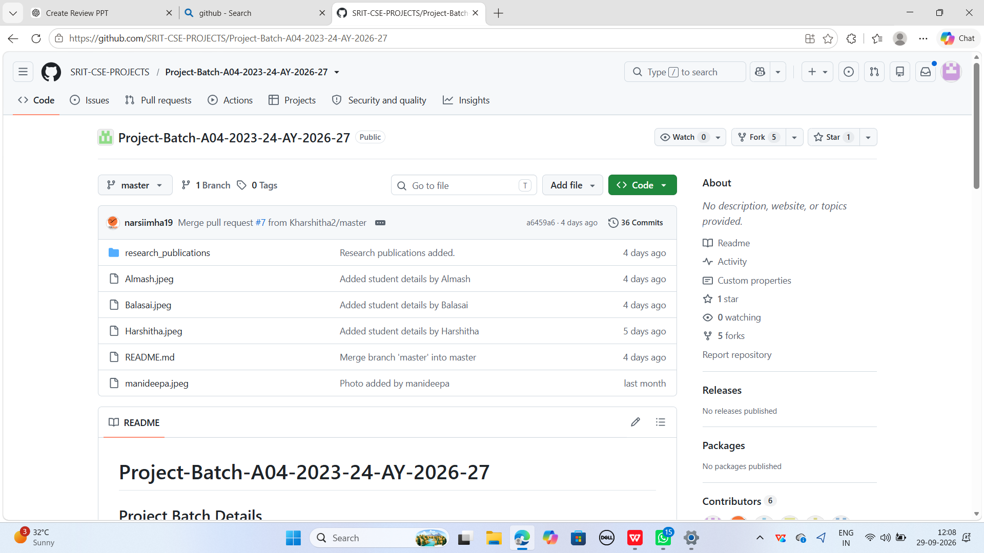
Git Hub Dashboards of each student
Link of the GitHub :
SRIT-CSE-PROJECTS/Project-Batch-A04-2023-24-AY-2026-27

Slide 11
Any Queries?

Slide 12

Thank You
K.Harshitha | B.Mani Deepa | S.Alamsh | K.Bala Sai
Batch No : A04
Guide: Mr. M. Narasimhulu, M.Tech, Assistant Professor of CSE

